Slide 1


Oracle database
Lecture 54

Slide 2

Today’s Agenda
Introduction To Oracle 12c
Understanding Cloud BasedMultiTenant Architecture
Container Database & Pluggable Databases
New Features

Slide 3
Introducing Oracle 12c
In the Oracle Database 12c the "c" stands for "Cloud” .
In addition to some new features, this new version of the Oracle Database implements a multitenant architecture, which enables the creation of pluggable databases (PDBs) in a multitenant container database (CDB)

Slide 4
Understanding MultiTenant Architecture
Multiple tenants share same resources on a mutual benefit for different purposes at a very broad level.
The same applies to Oracle Database where Multiple Databases share a single instance of resources aiming for different purposes on the same Server.
This Oracle Database which is built on Multitenant foundation is called Container Database(CDB), and each container(tenant) residing inside is called Pluggable Database(PDB, Container).

Slide 5
Container Database
Container Database (CDB) : Container database(CDB) is a main part of Multitenant database .
It houses all the things which are shared across all the pluggable database.
On the surface this seems very similar to a conventional Oracle database, as it contains most of the same working parts like datafiles,, redo logs etc.
It also holds the data dictionary for those objects that are owned by the root container and those that are visible to all PDBs.

Slide 6
Pluggable Database
Pluggable Database (PDB) : Pluggable database contains mainly user data.
It does not need to worry about controlfiles, redo logs and undo etc as they are managed by Container database.
Instead it is just made up of datafiles and tempfiles to handle it’s own objects. This includes it’s own data dictionary, containing information about only those objects that are specific to the PDB.

Slide 7
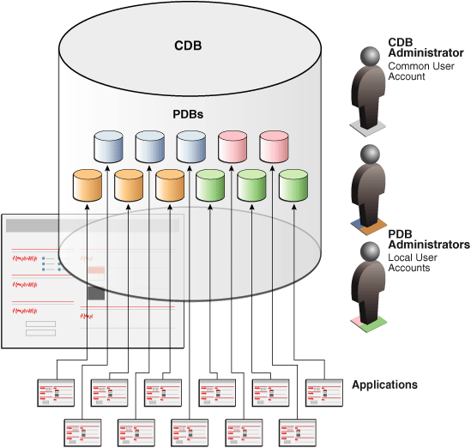
Pluggable Database

Slide 8
Oracle 12c New Features
Invisible columns :-> The idea of invisible columns is similar to the idea of creating a view on a table while leaving out the columns that we do not want the end-user to see.
In 12c we can now have an invisible column in a table.
When a column is defined as invisible, the column won’t appear in generic queries, or DESCRIBE command unless the column is explicitly referred to in the SQL statement or condition.

Slide 9
Oracle 12c New Features
It is pretty easy to add or modify a column to be invisible and vice versa:
CREATE TABLE emp (eno number(6), ename name varchar2(40), sal number(9) INVISIBLE);

Slide 10
Oracle 12c New Features
Truncate table CASCADE:->In the previous releases, there wasn’t a direct option provided to truncate a master table while it is referred to by the child tables and child records exist.
The TRUNCATE TABLE with CASCADE option in 12c truncates the records in the master table and automatically initiates a truncate on child tables too, subject to foreign key reference as ON DELETE CASCADE.

Slide 11
Oracle 12c New Features
This enhancement gets rid of the prerequisite to truncate all child records before truncating a master table.
TRUNCATE TABLE <table_name> CASCADE;

Slide 12
Oracle 12c New Features
Top N queries using FETCH FIRST and OFFSET:-> Oracle 12c eases the cases of top-N analysis by introducing FETCH FIRST clause in SQL language.
This clause is used to limit the number of rows returned by a query.
The new clause can be used in conjunction with ORDER BY to retrieve Top-N results.

Slide 13
Oracle 12c New Features
First Example:
SELECT *
FROM Employee
ORDER BY sal DESC FETCH FIRST 5 ROWS ONLY;
Second Example:
SELECT *
FROM Employee
ORDER BY sal DESC FETCH 25 PERCENT ROWS ONLY;

Slide 14
Oracle 12c New Features
Third Example:
SELECT *
FROM Employee
ORDER BY sal DESC OFFSET 5 ROWS FETCH NEXT 2 ROWS
ONLY

Slide 15
Oracle 12c New Features
Extended 32 K Limit-> Until Oracle 11g SQL, the maximum precision allowed for a string type column was 4000.
In Oracle 12c, the precision has been increased up to 32767 bytes or 32K.
The new string data types are known as Extended String Types in Oracle 12c.

Slide 16
Oracle 12c New Features
Handling default columns in Oracle 12c:-> Oracle 12c enhanced the defaulting methods of table columns.
Now, a column can default to a sequence.
In addition, a column can have a default value which will be used only when the column is NULL.

Slide 17
Oracle 12c New Features
create table t ( x number default myseq.nextval primary key, y number, z number default on null 13 );

